Slide 1

Recent Work in Connectivism
Stephen Downes
March 4, 2019

Slide 2
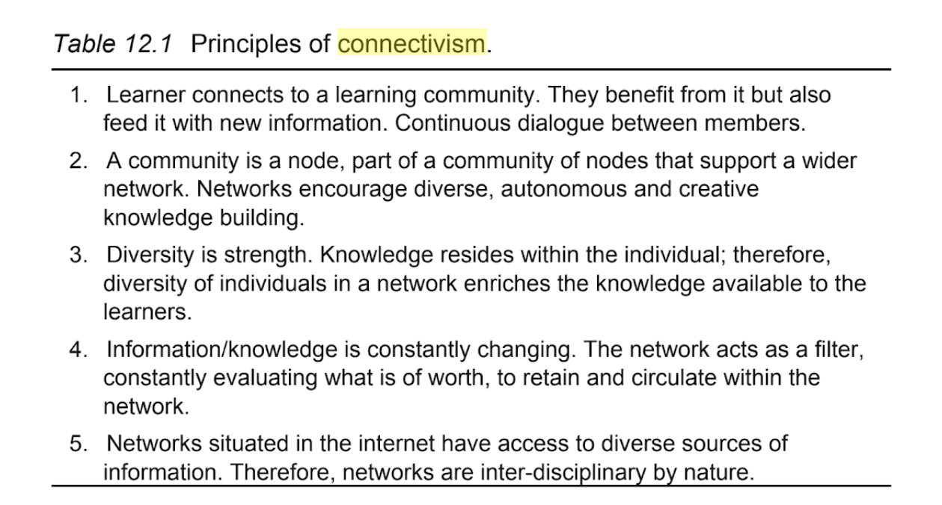
How Connectivism is Being Interpreted
Nature of Knowledge
Learning Process
Network Formation
Autonomy and Decision-Making
(Bowes and Swanwick, 2018)
Notes:
“According to Downes (2012), connectivism is the knowledge distributed across a network of connections, and, therefore, learning consists in the ability to construct and go across those networks. It implies that the links must precede the linked parts, the laws of interaction must precede their content and the relations between the subjects must precede the subjects that are related (quoting Marrero-Guillamón, 2012).”: +
“Connectivism refers to the knowledge that emerges in the network from the interaction within a group of knowledge construction. This means that there is no knowledge of any of the nodes in the network; connectivism is the knowledge that emerges in the network, in the interaction between nodes, and transcends its members in a collaborative knowledge building process. This process should not be perceived as a deterministic development, it may arise spontaneously, but it is something that should be encouraged.”
(J. A. Díaz y T. Hernández de Frutos, 2018)

Slide 3
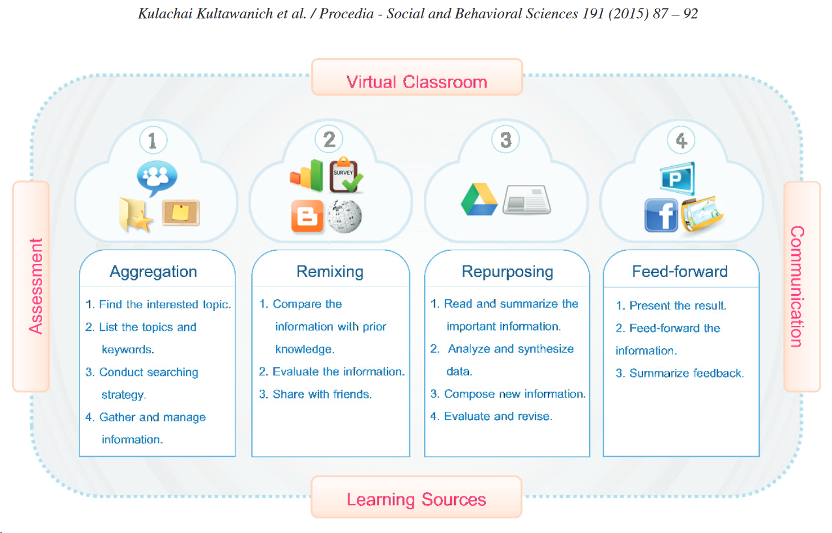
How Connectivism is Being Interpreted
Nature of Knowledge
Learning Process
Network Formation
Autonomy and Decision-Making
(Kultawanicha, Koraneekija, and Na-Songkhlaa, 2015).
Notes:
“The research results were as follows: (1) the proposed model has 5 components, namely Virtual Classroom, Cloud-based Tools, Role of Teacher, Learning Resources and Learning Assessment. (2) The model of connectivism learning consists of 4 steps including: (1) Aggregating, (2) Remixing, (3) Repurposing, and (4) Feed Forward.” (Kultawanicha, Koraneekija, and Na-Songkhlaa, 2015).
Connectivism is used to interpret and understand the processes related to learning and knowledge in the current world, particularly regarding the technological evolution of social networks and e-learning . Therefore, the principles of Connectivism should not be used to explain every kind of learning and knowledge as some gaps could be found in its principles. These gaps are covered by previous theories “complemented” by Connectivism in order to adapt them to the digital technological world. (Downes, 2008, 2013). In its endeavour to understand knowledge and learning, Connectivism defines the human mind as a network which adapts to its environment. Therefore, learning could be defined as the process of creating networks by means of connections among several nodes and knowledge would be held in these networks. The role of the learner is both active and creative because they need to constantly adapt to the changing environment by making new connections, identifying patterns and learning through the decision making experience (Siemens 2006, 2013). One of the main ideas in Connectivism is that knowledge is something unpredictable, unstable, uncontrollable and in continuous growth, which means that it goes beyond the total control of a person and might be in their external networks (communities, digital devices, etc.) constantly changing. Therefore, Connectivism is not only the idea of individual human knowledge and learning, but also an approach to understand the collective mentality of a network of individuals, a community or a society based on the same principle: the generation of network ecologies constantly changing and evolving.
(Cabrero and Román, 2018)

Slide 4
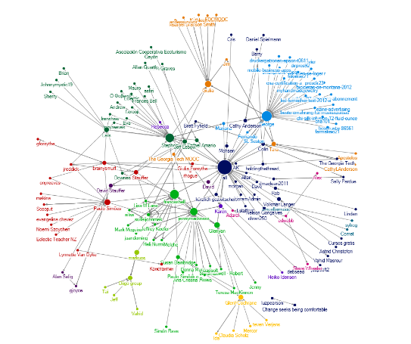
How Connectivism is Being Interpreted
Nature of Knowledge
Learning Process
Network Formation
Autonomy and Decision-Making
(Wang, Anderson and Chen, 2018)
Notes:
“Central in the connectivistic view on knowledge is that learning is a network formation process[12].
Networks in this context refer to online social networks which are adaptive, fluid, and readily scalable in size and scope.
Context in the connectivistic view includes elements like emotions, recent experiences, beliefs, and the surrounding environment
(Johansson, et.al., 2018)
The solutions proposed by the authors (to make schools smart) are as follows:
- Establishment of a network between schools, teachers and students to transfer experiences and to help update knowledge and learning of principals, teachers and students across the country.
- To be able to perform in the new world of knowledge, we need to see the connecting forces. Connectivism and connective knowledge, meaning-making, pattern recognition and absolute certainty are our required skills (Medhi Attar. 2018. )
“Decision-making is itself a learning process. Choosing what to learn and the meaning of incoming information is seen through the lens of a shifting reality. While there is a right answer now, it may be wrong tomorrow due to alterations in the information climate affecting the decision.” (Mlasi and Naidoo, 2018)
“Kropf (2013) describes 21st century students as “do-it-yourself” learners
(Hazeldine, Yardley and Shearman, 2018)

Slide 5
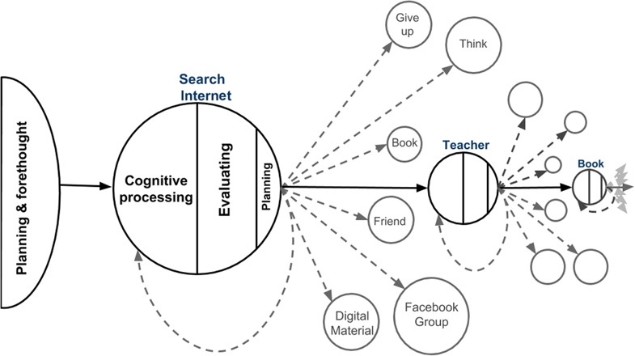
Criticisms of Connectivism
Inability to Self-Direct
Disconnection, demoralization
(AlDahdouh, 2018)
Notes:
Kop (2011), for instance, researched PLENK2010… The results showed that not all students were able to autonomously direct their own learning and master critical literacies,
Connectivism has yet to recognize how learners form connections to the variety of resources,
How a learner forms connection to a node can be summarized into three consecutive stages: (1) planning and forethought; (2) cognitive processing; (3) evaluating.
(AlDahdouh, 2018)
Mackness and Bell (2015) cited by (Gonçalves and Osório, 2018) - Although many students experienced the light side of the course, some had mixed feelings and experiences, while some even felt disconnected, demotivated, demoralized, disenfranchised, and disturbed — the dark side
there are no activities in MOOC that can be implemented collectively, so there is a tendency for the lack of involvement and participation of teachers. (Gonçalves and Osório, 2018)
“Connectivism as a teaching trend of virtual education threatens in a way the human condition with respect to their existential problems, their social ties, their values, due to the so-called, according to Bauman (2004), the generation of liquid modernity. So a new question arises: Has connectivism turned out to be a new behaviorism? Is it useful for the improvement of teaching-learning processes?”
(Pando, 2018)

Slide 6
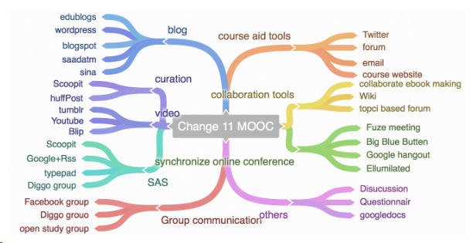
Connectivism as Pedagogy
MOOCs
Open Learning
Active Learning
Microlearning
(Wang, Anderson and Chen, 2018)
Notes:
The interaction around topics and topic generation supports the idea of learning as network creation after the analysis of participation patterns that are based on some deep interactive topic.
(Wang, Anderson and Chen, 2018)
One way the connectivism learning theory is being utilized is in Active Learning Classrooms (ALC) (however) Gebre et al. (2015) stated that for an ALC to be effective, three parts must be in place: the transmission of knowledge (which is wrong - SD), engagement of students and the ability to develop learning independence” (Profit, 2019)
“Five strategies for implementing connectivism in the traditional K-12 classrooms are (1) shifting from teacher-centered to student-centered pedagogy, (2) incorporating technology with readily-available devices, (3) never providing information that students can access themselves, (4) incorporate and practice utilizing technology networks, and (5) incorporate and practice utilizing social networks.” (Rice, 2018)

Slide 7
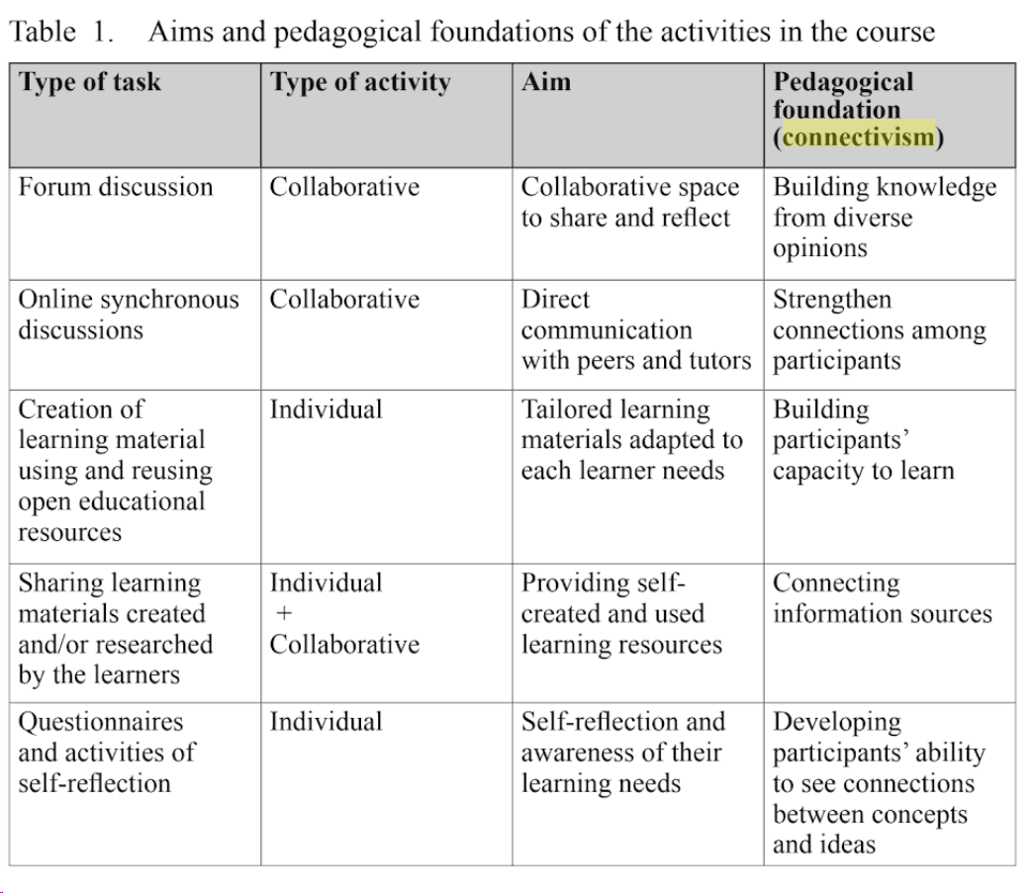
Connectivism as Pedagogy
MOOCs
Open Learning
Active Learning
Microlearning
(Fondo and Konstantinidis, 2018)
Notes:
“The theoretical basis of microlearning is connectivism, which focuses on the importance of our human capabilities to form connections between ideas, with each other and with different sources of information.”+”These connections between ideas in individual learners’ brains are formed, developed and maintained in what Siemens calls learning ecologies. Learning ecologies can vary in size, scope and complexity, but they are all composed of networks of individuals and information Sources.” (De Gagne, et. al., 2018)
“The principles are the same as those of OERs, that is, the contents organized and structured at the beginning of the course served more to initiate discussions and to foster curiosity rather than to be considered "absolute truths" or as contents to be memorized and reproduced in assessments.”
(Zaduski, Lopes and Schlunzen, 2018)

Slide 8
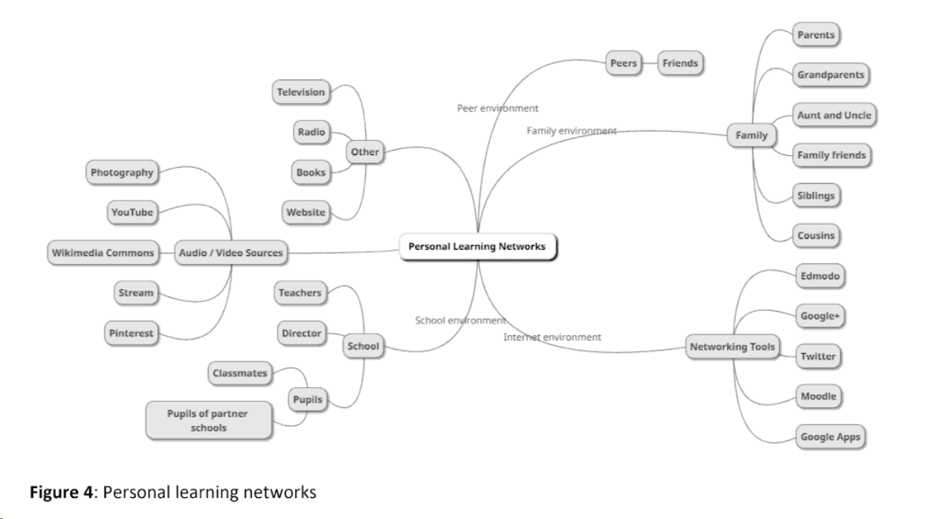
Connectivism as Pedagogy
Collaboration / Cooperation
Personal Learning Networks
Global Learning
(Homanova, et.al., 2018)
Notes:
the combination and allocation of group members should comply with the principle of voluntariness, but it should take equal role and group members perform their duties.” (Piao and Ma, 2018, talking about Teaching Design Strategy of Innovation and Entrepreneurship Course of College Students)
“investigates the global role of MOOCs in e-learning. MOOCs has emerged due to learning theories related to learners whether individuals or networks of learners. Therefore, this paper reviews Massive Open Online Courses characteristics, it spread around the world, its practical implementation in e-learning”
(Mahmod, Ali and Shah, 2018)
“Our model of Global Learning is an extension of Connectivism to offer an innovative and practical approach to the enormous problem of global Public Health human resource shortages.”
(Madhok, Frank and Heller, 2018)

Slide 9
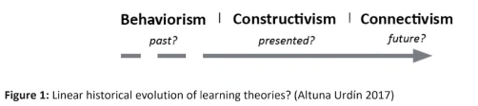
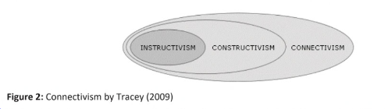
Connectivism as a Theory of Learning
Arguments that it’s Not
Does Not Explain Concept-Formation
Does Not Explain Teaching
Responses
(Homanova, et al., 2018)
Notes:
some authors argue that connectivism should not be considered a new theory of learning and/or question its fundamentals (Kerr, 2007; Kop & Hill,
2008; Kop, 2011; Bell, 2011; Clarà & Barberà, 2014), Anderson and Dron (2011, 2012) (Homanova, et al., 2018)
Connectivism can be perceived as an extension of existing theories, eg. by Tracey 2009. (Homanova, et al., 2018)
Connectivism is only the evolution of previous schools and not a theoretical revolution in pedagogy.” (Cabrero and Román, 2018)

Slide 10
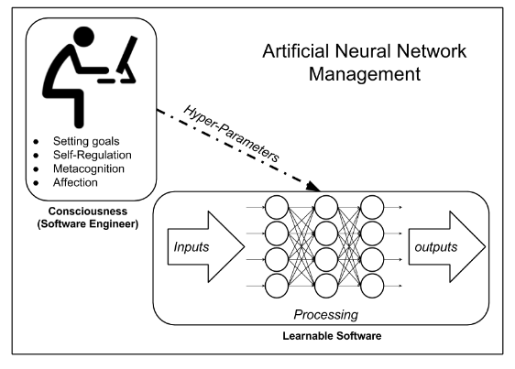
Connectivism as a Theory of Learning
Arguments that it’s Not
Does Not Explain Concept-Formation
Does Not Explain Teaching
Responses
(Al Dahdouh, 2017)
Notes:
(Marc Clarà and Elena Barberà )
the 'learning paradox.' This paradox, first posed by Socrates (Plato, 2002), can be applied to connectivism as follows: How do you recognize a pattern if you do not already know that a specific configuration of connections is a pattern?
connectivism underconceptualizes interaction and dialogue, by understanding it as a learner’s connection to a human node in the network.
connectivism is unable to explain concept development... if a concept consists of a specific pattern of associations, how can it be explained that the concept develops but the pattern of associations remains the same? Cf. Zheng, et.al. 2018 - does not explain how the information provided in the nodes is integrated into the existing knowledge structure of the network after the learning is built
The role of teachers and peer learning in a collective sense counterbalances this tendency.” (Ament and Edwards, 2018)
What does the person who is playing with the hyper-parameters represent in the human mind? (Al Dahdouh, 2017)

Slide 11
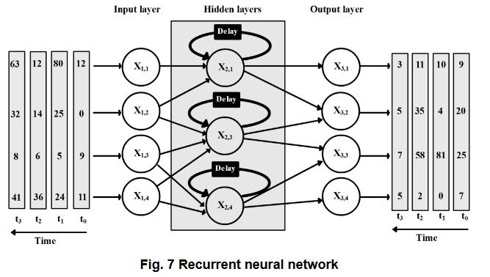
Basis for Connectivism in Research
Psychology
Neuroscience
Connectionism
Education
Chaos Theory
Complex Adaptive Systems
Sociology
(AlDahdouh, 2018)
Notes:
Gestalt main principles (similarity, proximity, continuation, etc.) are laws that show the way human mind make connections and associations.”
“ Discoveries in cognitive neuroscience re-lated to the operation of mirror neurons
The large-scale open network course (cMOOC) based on connectivism from the neurocognitive perspective - Al Dahdouh (2017) made a comparison between the assumptions of Connectivism and the artificial neural network program
“Connectivism agrees with Constructivism in a big part of this global view of the learner, as Connectivism also considers that the learner has a main role in the learning process
Connectivism, similarly to Chaos Theory, does not consider that learning is guided, creates a cognitive order and is intentional. They also agree in the idea of knowledge being constantly fluctuating, meaning that current knowledge
According to Levin (2002), the main characteristics of the Complex Adaptive Systems are the diversity and individuality of its components,
Conversation Theory, originally suggested by Pask (1975) ,Laurillard (1993, 1999) … Actor-Network Theory (ANT) [4], also known as “actant-rhizome ontology”. It is a sociological approach born in the 80s but theoretically developed at the end of the 90s mainly with the works of Latour (1999) and Law (1999).
Network Learning (N-learning) of Polsani (2003), inspired in the works of Harasim (1995).
(Cabrero and Román, 2018)

Slide 12
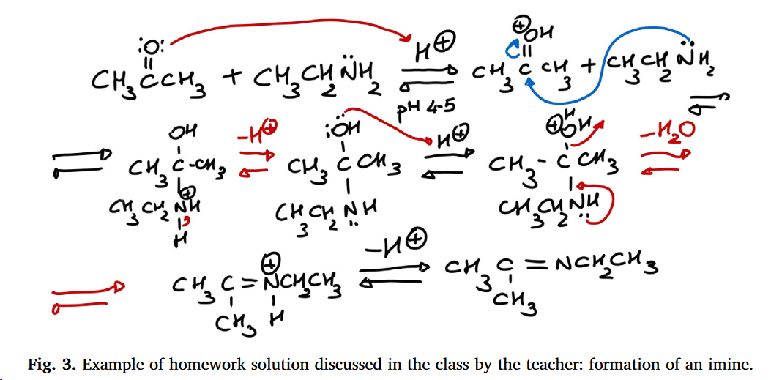
Evidence for Success
Improved motivation
Improved ability to learn
Reduction of errors
Performance improvements
(Angelini and Gasbarri, 2018)
Notes:
Motivation
“the experimental group which was trained using connectivism approach showed the more scores in the post-test of academic self-efficacy and task value compared toCLT approach… the use of connectivism theory in education and learning process will lead to increased motivational beliefs.” (Borna and Fouladchang, 2018a)
“most of the experts strongly agreed with using cloud-based tools and Connectivism learning method...” (Kultawanicha, Koraneekija, & Na-Songkhlaa, 2015)
positive motivational outcomes such as academic self-efficacy and task value in learners (Kultawanicha, Koraneekija, &Na-Songkhlaa, 2015; Prince, 2017). Hence, the attention to the above features seems to be among the key principles of connoctivism,” (Borna and Fouladchang, 2018a)
Autonomy and scaffolding represent the main components in promoting intrinsic motivation in learning pharmaceutical sciences, beside competence and relatedness.” The high scores associated with student performances reflect our efforts to improve their self-confidence with organic chemistry, confirming the importance of motivational approaches.” (Angelini and Gasbarri, 2018)

Slide 13
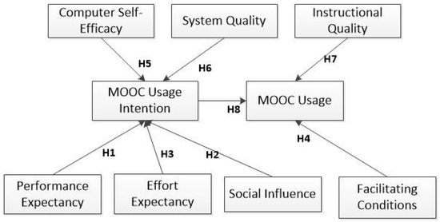
Evidence for Success
Improved motivation
Improved ability to learn
Reduction of errors
Performance improvements
(Fianu, et.al., 2018)
Notes:
Ability to Learn
It’s not social influence - (Fianu, et.al., 2018)
They learnt that people generally see the world not as it is, but as they are, or, as they are conditioned to see it.” (Shrivastava, 2018)
“Students in higher education learning environments will prepare for the future when they become self-directed learners and more motivated by learning than performance”
Learners must control their own self-study method and apply various learning methods to autonomous learning. Learning process and the learning outcome will relate to experience and building up new experience. And learners will create meaning through understanding and lifelong process” (Sarnok and Wannapiroon,2018)

Slide 14
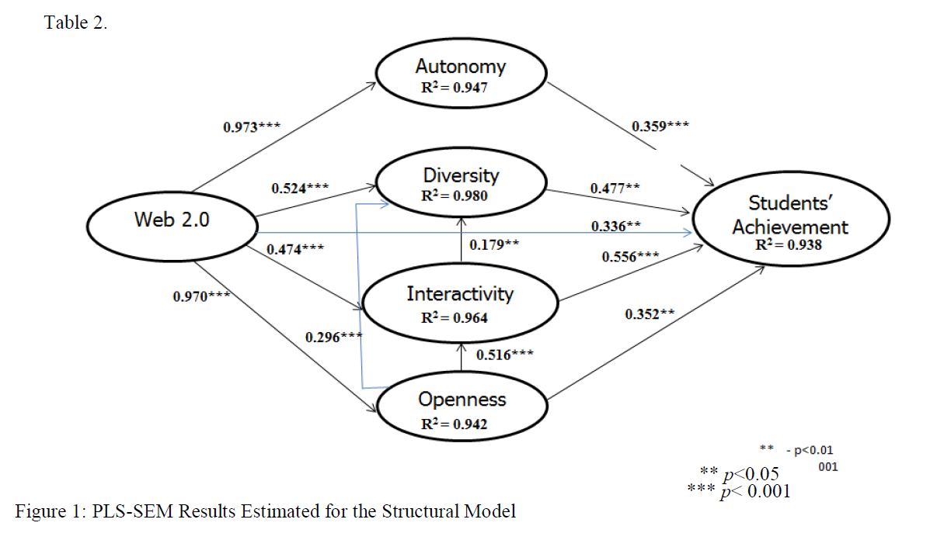
Evidence for Success
Improved motivation
Improved ability to learn
Reduction of errors
Performance improvements
(Zulkifley Mohamed and Nor Ubaidullah and Siti Yusof, 2018)
Notes:
Improved Outcomes based on Method
Connotation of Relevance Theory - -- “the proposed method can effectively reduce the error rate of students (Cao, 2018)
“the study revealed that autonomy, diversity, interactivity, openness and Web 2.0 have a positive significant effect on students' achievement. (Zulkifley Mohamed and Nor Ubaidullah and Siti Yusof, 2018)
Learning process and the learning outcome will relate to experience and building up new experience. . (Sarnok and Wannapiroon,2018)
trends in performance improvement concerning highly important concepts were identified.” (Réka Vas, Christian Weber, Dimitris Gkoumas, 2018)
The results showed the connectivism instructional method was significantly more effective than grammar-translation method.”
The explanation for this finding is that the students in the approach based on connectivism theory have opportunities to increase academic engagement through diversity and attention to the individual's interest in choosing content or tasks,the use of connected chanelles, constructive interaction with human and in human resources, managing all or part of the learning and knowledge available, and up-to-date through access to digital space” (Borna and Fouladchang, 2018b)

Slide 15
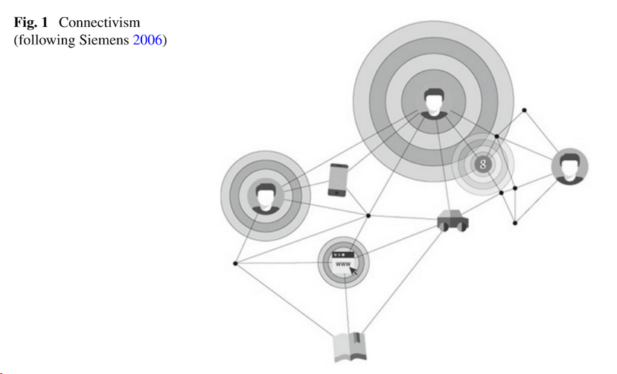
Moving Forward
Critical Thinking and Deep Learning
Rhizomatic Learning
Social Networking
Cognitive Cities
(Tabacchi, et.al., 2018)
Notes:
based on the theory of connectivism, educators take an essential role in digital learning.” (Wei and Hu, 2018)
The author believes that critical thinking is a means to achieve deep learning, the cultivation of critical thinking ability and other higher-order thinking ability is the goal of deep learning, while deep learning research is the focus of learning science research. (Honglin, 2018)
t is important to reflect on concepts such as open education, open educational resources, connectivism and rhizomatic learning environments, given that these are themes that are articulated and strengthened due to the cybercultu” (Zaduski, Lopes and Schlunzen, 2018)
giving students a sense of control also seems to be vital in successful SNS use. In this case, it was done through students’ control over the content and direction of the debate and how and when they engaged in online negotiation.” (Pallas, Eidenfalk and Engel, 2018)
Cognitive cities … vs ‘top down’ smart cities (Tabacchi, et.al., 2018)

Slide 16
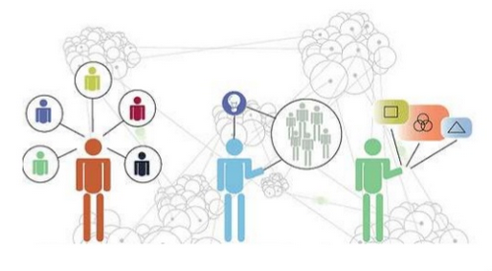
Thinking of Connectivism More Widely
Building Relationships
Distributed Cognition
Co-Creation
Austen, Chen, Darlington, Daylamani-Zad, De’Cage and Farrant, 2014
Notes:
Connectivism foresees a better understanding of a society in constant change and a knowledge continuously growing. - (Cabrero and Román, 2018)
Hallmarks of best teaching and learning practices: personalization, agency, authentic audience, connectivist, creativity - (Tucker, Wycoff and Green, 2017)
A combination of flexibility in learning with supported learner autonomy leads to both the development of learners’ understanding and confidence” (Hazeldine, Yardley and Shearman, 2018)
a robust, heterogeneous personal learning network that allows me to collaborate with people around the globe. (Ankel and Swaminathan, 2018)
“the Open Source Educative Processes framework (OSEP; Glassman et al. 2011; Glassman & Kang 2016) posits that online communities have become a driving force in knowledge production and dissemination… (Kuznetcova, Glassman and Lin, 2018)
Virtual Communities of Building Knowledge (VCBK) … “GNU/Linux is a program developed by a VCBK.” (Diaz and de Frutos , 2017)
learning and knowledge are not transferred from one network member to another, but rather the product of the creative acts of all members’ interactions.
That was the key moment when the course 6.002x becomes a VCBK
Perhaps the most important aspect of a MOOC is that learning and knowledge are the result of group interaction by means of technology… Diaz and de Frutos , 2017)

Slide 17

https://www.downes.ca

